Slide 1
Concepts for Testing Continuous Behavior with TTCN-3
TTCN-3 embedded, TTCN-3 extensions to test continuous behavior

Slide 2
Testing Continuous Systems

Slide 3
Testing Continuous Systems
Continuous systems deal with physical
A continuous signal is expressed as a function of a real-valued domain, usually time.
Sampling provides a projection of continuous signals to the domain of discrete signal processing.
Filters and transformations are used for noise reductions and signal preparation
TTCN-3 addresses communication based systems, i.e. messages, procedure calls.
TTCN-3 embedded provides means to:
intuitively define continuous signals for system stimulation
reasonable specify assessments for the reactions of continuous systems
Notes:
Intention:
Show that the actual version of TTCN-3 is not appropriate to specify tests for continuous systems.
It might be possible to express continuous system stimulation by use of parameterized messages or procedures that express the start and the kind of a signal (e.g. message(sin,value), message(constant,slope) etc.)
Assessment of system reaction is not possible.
Additional Explanations:
TTCN-3 is a procedural testing language: test behav-
ior is dened by algorithms that typically assign (send)
messages to ports and evaluate messages (receive) from
ports3. The evaluation of messages is done along the
TTCN-3 snapshot semantics [7, 12]: for the evaluation
of dierent alternatives of expected message (sets) or
timeouts, the port queues and the timeout queues are
frozen. Whereas the snapshot semantics provide means
for a pseudo parallel evaluation of messages from several
ports, there is no notion of simultaneous stimulation and
sampled evaluation.
Additional Explanation:
A continuous signal is a varying quantity (a signal) that is expressed as a function of a real-valued domain, usually time. The function of time need not be continuous.
The signal is defined over a domain, which may or may not be finite, and there is a functional mapping from the domain to the value of the signal. The continuity of the time variable, in connection with the law of density of real numbers, means that the signal value can be found at any arbitrary point in time.
A typical example of an infinite duration signal is:

Slide 4
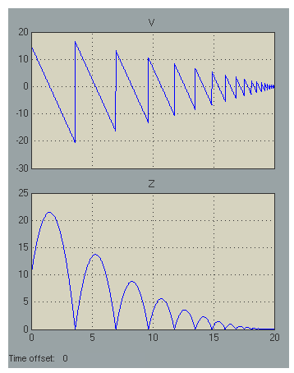
Characteristics of Continuous Systems
Example: Bouncing Ball
A rubber ball is thrown into the air with a velocity of 15 meters per second from a height of 10 m
Valuation over time
Assessment of system properties by differential equation
assert(derivative(z, „Taylor“)== v.value)

Slide 5
TTCN-3 embedded Main Concepts
Sampled Time as a common basis for discretization and stream and template definitions.
Sampled Streams that provide a data structure to define, access and manipulate discretized signal values and their history in time.
Assertions to express expectations on incoming streams.
Hybrid Automatons, that provides a control flow structure to enable and control the simultaneous stimulation and evaluation of stream ports
Real Time Semantics for execution
Notes:
Intention:
Provide an overview over the basic means of Continuous TTCN-3
Additional Explanation:
Stream:
A stream is a ow of data over time, which has a data
value being dened for every point in time the stream
elements. We dene streams relative to a sample that repre-
sents global time. In contrast to scalar values, a stream [2,9] represents the whole allocation history
applied to a port. In CTTCN-3 the term stream is used to denote the data
structure that describes the complete history of data that yield
as allocation of a certain port xn; ym.
As scalar types, all TTCN-3 base types and user-dened structured types
(and their restrictions) are allowed.
Stream Templates
In TTCN-3, especially for the denition of reference val-
ues and value sets, the use of templates is encouraged.
A template denes a pattern for the characterization of
values of a given type. Templates are generally applicable to streams of the same type or of
compatible type4. In CTTCN-3 the application of a template to a stream or a
stream port is carried out by either a sense statement (for the on-line evaluation
of ports) or a match statement (for the oine evaluation of the data structure
stream).
Time:
The notion of time is crucial for testing continuous or
hybrid systems. In standard TTCN-3, there is restricted
time control using timer operations only. Especially for
the exact timing of stimulation events and the time quan-
tied evaluation of system reactions the use of timers
is cumbersome and imprecise. Hence, in TimedTTCN-3 global time5 and the notion of timestamps were intro-
duced [18, 4]. Access to global time is provided by an
operation called now that returns the actual time in sec-
onds. We adopt the concept of global time and enhance
it with the notion of sampling and sampling time. As
in TTCN-3, all time values in Continuous TTCN-3 are
denoted as non-negative oat values and represent time
in seconds.
Carry Until:
Although structured types can be used to emit and sense several
scalar streams in parallel and although finite
streams can be used instead of infinite ones, it is not always
applicable and practical to do that. Therefore, we introduce
a new control flow structure that enables the generation of
streams (and of messages and procedures) on parallel ports.
Like the alt statement, it also supports the parallel evaluation.
The proposed control flow structure is called carry-until
statement.

Slide 6
Time & Sampling & Streams

Slide 7
Time
Time progress starts with the begin of a test case
Is available as float value by means of symbol now
Preciseness is limited by the test system (base sampling)
x:=now+2.0;
if(now>20.0) { //do something}

Slide 8
Streams
Data Structure that represents a flow of data over time
yield actual data and a history of data
stream types collate the scalar value type of a stream
sampling defines the precision of information
TTCN-3 embedded provides
stream ports to communicate between components and environment
a mapping between streams and TTCN-3 record structures
type port FloatInStream stream {in float};
type port FloatOutStream stream {out float};
type component tester{
port FloatInStream inPort;
port FloatOutStream outPort;
}

Slide 9
Access to Stream Data (Read/Write)
TTCN-3 streams provide information about values and their timing:
.value provides access to the actual stream value
.timestamp returns the measurement time of a value
.delta provides access to the length of a sampling step
outPort.value:= 10.0;
outPort.value:= inPort.value + 10.0;
if (outPort.timestamp > 10.0) {…}
if (outPort.delta > 0.001) {…}
outPort.delta := 0.001;

Slide 10
Stream Navigation
Allow the evaluation of the stream history
.prev(integer index) provides an indexed based access to previous stream values, timestamps and sample times
.at(float timeval) provides a time based access to previous stream values, timestamps and sample times
inPort.prev.value; // the previous value
inPort.prev(2).timestamp // the timestamp of the // measurement two samples // ago
inPort.at(0).value; // the initial value
inPort.at(10).timestamp // the timestamp of the // last measurement at // 10.0s or before

Slide 11
Delayed Effectiveness
Please note: out ports show a delayed effectiveness with myport.value:= 10.0 becomes internally and externally active at the next sampling step.
x:= myport.prev.value
myport.value:= 10.0
x:= myport.value
x:= myport.at(8.0).value
0.0
4.0
10.0
20.0
25.0
now

Slide 12
Definition of Assertions
Automatically set the fail verdict when hurt.
Applicable to any kind of boolean expression (including expressions with stream data)
assert(inPort.value > x or inPort.prev.value > y );
assert(expression1, expression2, …);
Shortcut for:
if(not expression) setverdict(fail);

Slide 13
Integration with TTCN-3 Data Structures
Mapping between TTCN-3 embedded streams and TTCN-3 record structures
type record measurement<T>{
T value,
float delta,
}
type record of measurement <float> StreamRecT;
var StreamRecT myStreamRec := port.history(start, end);
outPort.apply(myStreamRec);
outPort.find(myStreamRec);

Slide 14
Using TTCN-3 Templates
Allows the definition of tolerances and simple signal patterns
? (any value), (1.0, 2.0, 3.0) lists, (1.0..3.0) ranges
var template StreamRecT t_toCheck;
t_toCheck:= {
{value:= (50.0..60.0), delta:=0.0},
{value:= ?, delta:=5.0},
{value:= (60.0..70.0), delta:= (1.1..1.8)},
{value:= (65.0..75.0), delta:=4.0}
}
port.violates(t_toCheck);
port.find(t_toCheck);

Slide 15
Control Structure

Slide 16
Hybrid Automaton: Modes and Transitions
Cont. Test
Behavior
[g_2]/
event/
Cont. Test
Behavior
Cont. Test Behavior
[g_4]/
[g_3]/
[g1]

Slide 17
Application of Continuous Behavior
… by defining the modes of a test system
Simple semantics:
Repeat the content specification respecting the sampling of content elements
Sampling of content elements is transitively defined by the sampling of the individual streams
cont{
outPort.value:=inPort.value*2.0;
assert(inPort.value > 0.0);
}until (g1)
Cont. Test
Behavior
[g1]
Notes:
Assignments: Sampling of the left side argument
Predicats: Each sampling of streams that are contained in the expressions

Slide 18
Detection Of Complex Events
v==v’
v>v’ || v<v’
[duration>5.0]/
If the velocity remains constant for more than 5 sec., it shall not underrun the limit x for 5 seconds.
To detect: the velocity remains constant for more than 5 seconds
To check: v shall not underrun the limit x for 5 seconds
assert(v>x)
[duration>5.0]/

Slide 19
Textual Representation
v>v’ || v<v’
v==v’
seq{
label start;
cont{}inv{ v.value > v.prev.value or
v.value < v.prev.value}
cont{}inv{ v.value == v.prev.value}
until{
[duration > 5.0]{}
[notinv] {} goto start;
}
cont{assert(v.value > x)} until (duration > 5.0)
}
until(duration>60.0)
[duration>5.0]/
assert(v>x)
[duration>5.0]/

Slide 20
Features of Mode Specification
Different kind of modes:
atomic modes: cont, final
composite modes: par, seq
Optional definition of:
mode invariants
alternative branching and transitions to other modes
Features for mode reuse and mode extension
Explicit access to the duration of mode execution

Slide 21
Reuse

Slide 22
Defining Reusable Items
Using established TTCN-3 concepts:
Substitution and Symbols (functions, templates, constants)
Parametrization (parametrizable test cases, functions, and templates)
Modification Operators (template modification)
Introducing parametrizable and modifiable modes
Introducing libraries dedicated to test continuous systems

Slide 23
Paremtrizable Modes
v>v’ || v<v’
v==v’
mode myMode(in float x) seq{
label myModestart;
cont{}inv{ v.value > v.prev.value or
v.value < v.prev.value}
cont{}inv{ v.value == v.prev.value}
until{
[duration > 5.0]{}
[notinv] {} goto start;
}
cont{assert(v.value > x)} until (duration > 5.0)
}
until(duration>60.0)
myMode(10.0);
myMode(40.0);
[duration>5.0]/
assert(v>x)
[duration>5.0]/

Slide 24
Advanced Parameterization
Parameters allowed (timers, templates, modes)
runs on clause assigns definition to components
type mode MyModeType cont(in float i)
mode MyModeType mode2(in float i)
runs on MyComp cont{x:=i};
mode mode1(inout float param1, in float param2,
out float param3, MyModeType mode2) runs on MyComp
seq{
mode2();
cont{x:=2;y:=param1;}
until { // Transition
[duration>param2] {param3=z;}
}
}

Slide 25
Tooling and Examples

Slide 26
TTCN-3 embedded Compiler
Development Environment based on Eclipse
Support for different target languages
C# for the integration with Microsoft based tools (Vector CANoe)
C for the integration with Matlab/Simulink, AUTOSAR and RT-Systems
Goal: Explorative Validation of TTCN-3 embedded concepts

Slide 27
Compiler Tool Chain
Flexible Adaptation of Test Design Use Cases
TTCN-3 embedded Compiler
Textual Editor
TTCN-3 Metamodell
C# Runtime
Grafical editor
Parser
EMF Model
C Runtime
AUTOSAR Interface Import
Code Generator

Slide 28
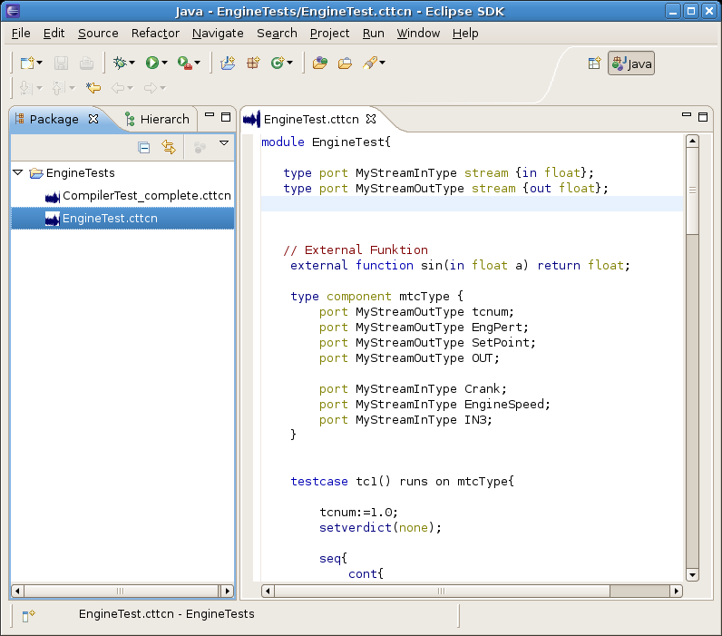
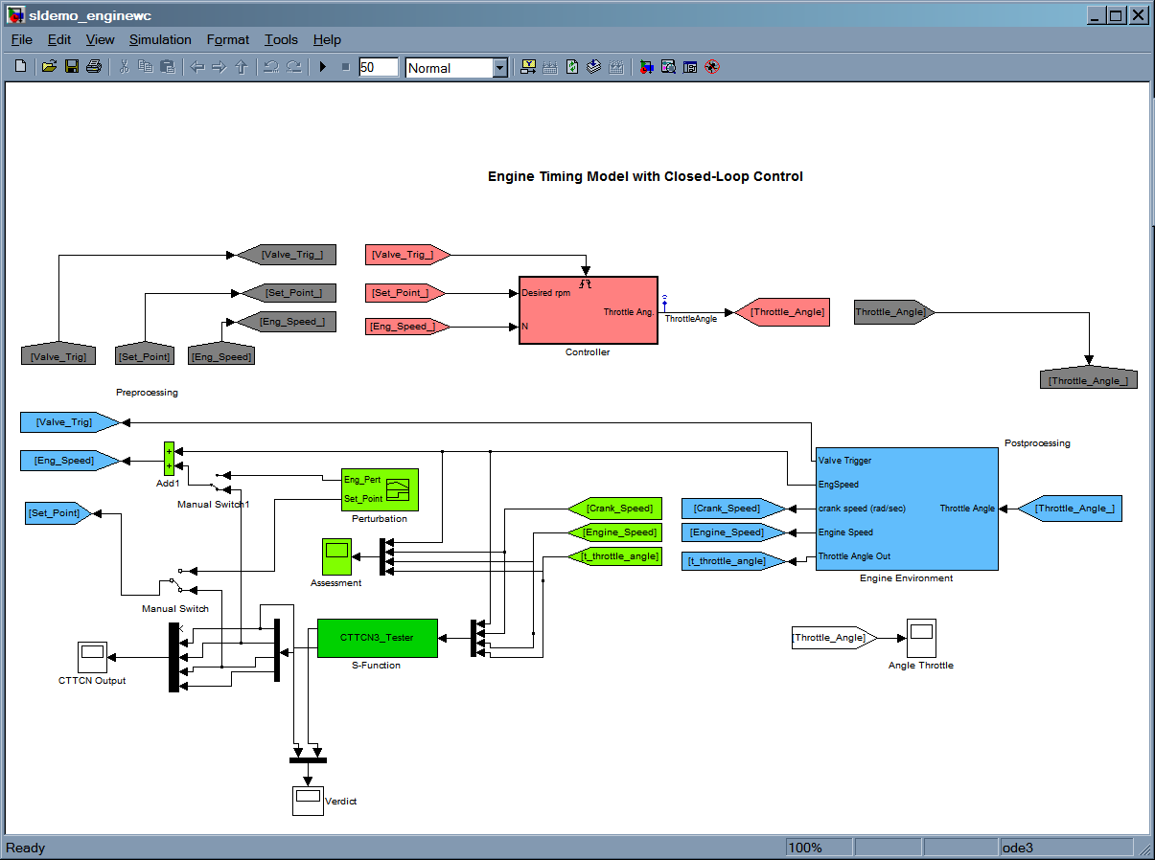
Platform for Matlab Simulink
TTCN-3 Source
TTCN3 Model
C-Code
Simulink S-Funct.

Slide 29
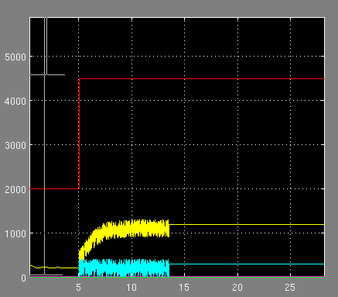
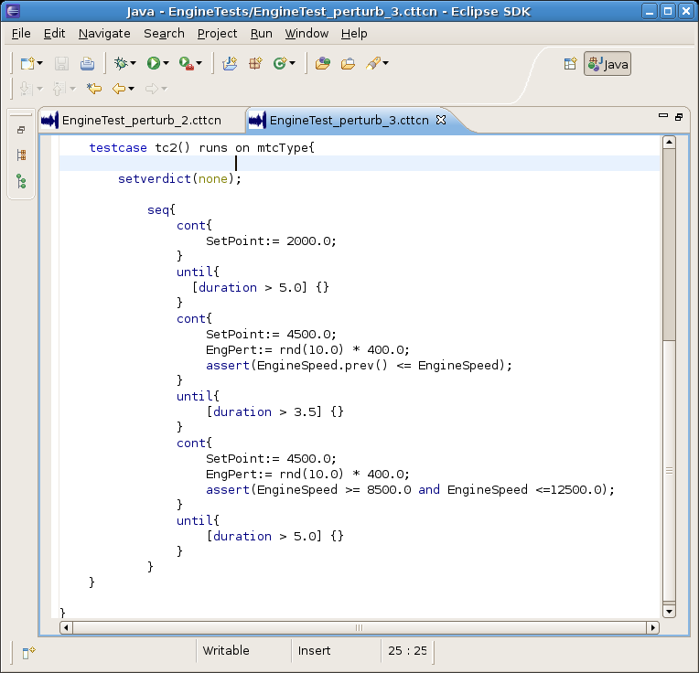
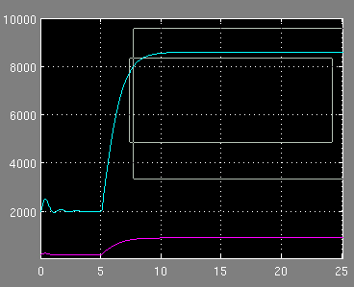
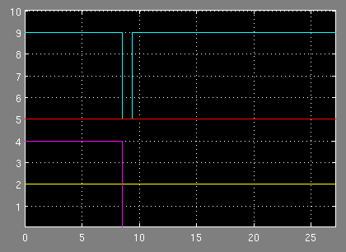
Test case: Throttle Control

Slide 30
Summary and Outlook
RT and continuous concepts for TTCN-3 embedded are nearly finished
Explorative compiler available soon
Finishing and polishing of concepts until the end of 2009
Evaluation of concept in the context of AUTOSAR
Standardization at ETSI

Slide 31
Contact and Info
www.temea.org
Jürgen Großmann
Fraunhofer FOKUS
Kaiserin-Augusta-Allee 31,10589 Berlin
Tel: +49-30-3463-7390
juergen.grossmann@fokus.fraunhofer.de
Notes:
Kurzprofil Fraunhofer Institut FOKUS
Die gestiegen Herausforderungen im Automotive Software Engineering sind die Treiber für die Forschungs- und Entwicklungsarbeiten am Fraunhofer Institut FOKUS.
Automotive Software schafft innovative Sicherheitssysteme, befindet sich jedoch im Spannungsfeld von Kostenreduktion und Qualitätssteigerung

