Slide 1
Concepts for Testing Continuous Behavior with TTCN-3
CTTCN-3, TTCN-3 extensions to test continuous behavior

Slide 2
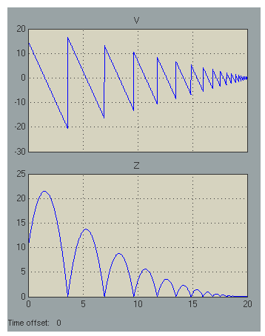
Characteristics of Continuous Systems
Example: Bouncing Ball
A rubber ball is thrown into the air with a velocity of 15 meters per second from a height of 10 m
Valuation over time
Assessment of system properties by derivation of signal curves

Slide 3
Testing Continuous Systems
Continuous systems deal with physical data (provided by sensors, actuators).
A continuous signal is expressed as a function of a real-valued domain, usually time.
Sampling provides a projection of continuous signals to the domain of discrete signal processing.
Actually TTCN-3 addresses communication based systems, i.e. messages, procedure calls
TTCN-3 do not provide means to:
intuitively define continuous signals for system stimulation
reasonable specify assessments for the reactions of continuous systems
Notes:
Intention:
Show that the actual version of TTCN-3 is not appropriate to specify tests for continuous systems.
It might be possible to express continuous system stimulation by use of parameterized messages or procedures that express the start and the kind of a signal (e.g. message(sin,value), message(constant,slope) etc.)
Assessment of system reaction is not possible.
Additional Explanations:
TTCN-3 is a procedural testing language: test behav-
ior is dened by algorithms that typically assign (send)
messages to ports and evaluate messages (receive) from
ports3. The evaluation of messages is done along the
TTCN-3 snapshot semantics [7, 12]: for the evaluation
of dierent alternatives of expected message (sets) or
timeouts, the port queues and the timeout queues are
frozen. Whereas the snapshot semantics provide means
for a pseudo parallel evaluation of messages from several
ports, there is no notion of simultaneous stimulation and
sampled evaluation.
Additional Explanation:
A continuous signal is a varying quantity (a signal) that is expressed as a function of a real-valued domain, usually time. The function of time need not be continuous.
The signal is defined over a domain, which may or may not be finite, and there is a functional mapping from the domain to the value of the signal. The continuity of the time variable, in connection with the law of density of real numbers, means that the signal value can be found at any arbitrary point in time.
A typical example of an infinite duration signal is:

Slide 4
CTTCN-3 Main Concepts
Global Sampled Time as a common basis for discretization and stream and template definitions.
Sampled Streams that provide a data structure to define, access and manipulate discretized signal values and their history in time.
Assertions to express expectations on incoming streams.
Hybrid Automatons, that provides a control flow structure to enable and control the simultaneous stimulation and evaluation of stream ports
Real Time Semantics for execution
Notes:
Intention:
Provide an overview over the basic means of Continuous TTCN-3
Additional Explanation:
Stream:
A stream is a ow of data over time, which has a data
value being dened for every point in time the stream
elements. We dene streams relative to a sample that repre-
sents global time. In contrast to scalar values, a stream [2,9] represents the whole allocation history
applied to a port. In CTTCN-3 the term stream is used to denote the data
structure that describes the complete history of data that yield
as allocation of a certain port xn; ym.
As scalar types, all TTCN-3 base types and user-dened structured types
(and their restrictions) are allowed.
Stream Templates
In TTCN-3, especially for the denition of reference val-
ues and value sets, the use of templates is encouraged.
A template denes a pattern for the characterization of
values of a given type. Templates are generally applicable to streams of the same type or of
compatible type4. In CTTCN-3 the application of a template to a stream or a
stream port is carried out by either a sense statement (for the on-line evaluation
of ports) or a match statement (for the oine evaluation of the data structure
stream).
Time:
The notion of time is crucial for testing continuous or
hybrid systems. In standard TTCN-3, there is restricted
time control using timer operations only. Especially for
the exact timing of stimulation events and the time quan-
tied evaluation of system reactions the use of timers
is cumbersome and imprecise. Hence, in TimedTTCN-3 global time5 and the notion of timestamps were intro-
duced [18, 4]. Access to global time is provided by an
operation called now that returns the actual time in sec-
onds. We adopt the concept of global time and enhance
it with the notion of sampling and sampling time. As
in TTCN-3, all time values in Continuous TTCN-3 are
denoted as non-negative oat values and represent time
in seconds.
Carry Until:
Although structured types can be used to emit and sense several
scalar streams in parallel and although finite
streams can be used instead of infinite ones, it is not always
applicable and practical to do that. Therefore, we introduce
a new control flow structure that enables the generation of
streams (and of messages and procedures) on parallel ports.
Like the alt statement, it also supports the parallel evaluation.
The proposed control flow structure is called carry-until
statement.

Slide 5
Time
Time progress starts with the begin of a test case
Is available as float value by means of symbol time
Preciseness is limited by the test system (base sampling)
x:=time+2.0;
if(time>20.0) {do something}

Slide 6
Streams
Data Structure that represents a flow of data over time
yield actual data and a history of data
stream types collate the scalar value type of a stream
sampling defines the precision of information
CTTCN-3 provides
stream ports to communicate between components and environment
stream variables to store temporary data
type port FloatStream stream {in float};
stream float streamvar;

Slide 7
Valuation of Streams
Streams (ports and variables) can be accessed like ordinary variables
Stream initialization during declaration
Please note: stream ports show a delayed effectiveness with outPort‘:=inPort
outPort:=3.0*inPort+4.0;
streamvar:=2.0 * inPort + outPort;
stream float myVar:=2.0;

Slide 8
Advanced Sampling
In General: discrete and dynamic sampling
discrete sampling to control stimulation on outgoing ports
dynamic sampling can be applied for reason of advanced measurement and data optimization for incoming ports
Sampling can be specified for multiple entities
modules, components, test cases, stream ports etc.
the stepsize has to be the multiple of the base sampling
type port FloatStream stream {out float}
with {stepsize := 0.0001};

Slide 9
Use of “Stepsize” Annotation
module{
type port FloatInStream stream {out float}
with {stepsize:=0.1};
type port FloatOutStream stream {in float}
type component tester{
port inPort FloatInStream;
port outPortFloatOutStream:=0;
}
...
} with {stepsize :=0.001};

Slide 10
Access to Stream Values
Stream access methods that yield
actual value, previous value, and
duration of last sampling period
0.0
4.0
10.0
20.0
25.0
time
inPort.value // yields actual stream value
inPort.prev.value // yields last stream value
inPort.prev(x); // yields stream value x samples
// ago

Slide 11
Time Based Access
Stream value at a certain time point
Distance to last valid measure before time point
0.0
4.0
10.0
20.0
25.0
time
inPort.at(0.0).value;// yields initial stream value
inPort.at(4.0).value;
// dist. between last measure and start of testcase
inPort.at(12.0).value;
// yields stream value at 10.0

Slide 12
Timestamp and delta
Stream value at a certain time point
Distance to last valid measure before time point
0.0
4.0
10.0
20.0
25.0
time
inPort.at(5.0).delta;
// yields the initial stream value
inPort.prev.delta;
// dist. between last measure and start of testcase
inPort.at(12.0).value;
// yields stream value at 10.0
inPort.at(12.0).timestamp;
// yields 10.0

Slide 13
Definition of Assertions
Automatically set the fail verdict when hurt.
Applicable to any kind of boolean expression
assert(some boolean expression);
assert(boolean expression, boolean expression, …);
Shortcut for:
if(not boolean expression) setverdict(fail);

Slide 14
Application of Continuous Behavior
… by defining the modes of a test system
Simple semantics:
Repeat the content specification respecting the sampling of content elements
Sampling of content elemetns is transitively defined by the sampling of the individual streams
cont{
outPort:=inPort*2.0;
assert(inPort>0);
}
Notes:
Assignments: Sampling of the left side argument
Predicats: Each sampling of streams that are contained in the expressions

Slide 15
Features of Mode Specification
Different kind of modes:
atomic modes: cont, final
structured modes: par, seq
Optional definition of:
mode invariants
alternative branching and transitions to other modes
Features for mode reuse and mode extension
Explicit access to the duration of mode execution (similar to time but local to mode)

Slide 16
Specification of Invariants and Transitions
label l1;
cont{
outPort:=4; // cont only
assert(inPort.prev>5.0); // cont only
}
inv{
a>3;
x<4+y;
}
until{
[a>3] p.receive(m){do something} goto l1;
[not inv] p.receive(m){do something else};
}

Slide 17
Transitions: Syntactical Variants
Short cuts to ease the specification of transitions
until(exp); // short cut for until{[exp]{}}
until{p.receive(m) goto ref};
// short for until{[true] p.receive(m) {} goto ref};
cont{}inv{expr}
until{[notinv] {do something else}}
// short for until{[not expr] {do something else}}

Slide 18
Mapping to Hybrid Automaton
label l1;cont{}inv{inv_1}
until{
[g2] {} goto l2;
[g2]p.receive(event) {} goto l2;
[true] goto l2;
[not inv] p.receive(m){do something else};
}
label l2;cont{}inv{inv_2}
until{
[g_3] goto l1;
[g_4] break;
}
label l1;cont{}inv{inv_1}
until{
[g2] {} goto l2;
[g2]p.receive(event) {} goto l2;
[true] goto l2;
[not inv] p.receive(m){do something else};
}
label l2;cont{}inv{inv_2}
until{
[g_3] goto l1;
[g_4] break;
}
[g_2]/
event/
inv_2
inv_1
[g_4]/
[g_3]/

Slide 19
Mode Semantics: Mapping to FSM
[g_2 && inv_2]/
[inv_2] event/
inv_2
inv_1
[inv_2]/
[g_4]/
[!inv_1 && inv_2]/
[!inv_1]/error
[g_3 && _inv_1]/

Slide 20
Parallel and Sequential Composition Modes
label l1;
seq{
par{
cont{outPort:=1.0}
cont{outPort2:=2.0}
}until(duration>10.0)
cont {outport:=3*duration}
}
inv{i1}
until{
[g_1] p.receive(m){do something} goto l1;
[finished] {do something else};
}

Slide 21
Features of Structured Modes
par and seq modes contain other modes only
seq starts the first child mode
the seq mode has finished internally when
the last child mode has finished
the break command has been executed
par mode starts all child modes
par mode has finished internally when
when all child node have finished
the finished symbol evaluates to true when a mode has finished internally

Slide 22
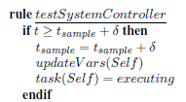
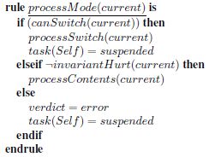
Operational Semantics
testSystemController defines sampling steps
processMode is scheduled for each step

Slide 23
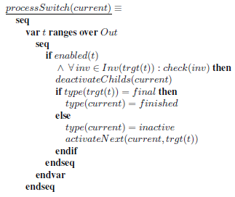
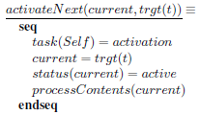
Switch Semantics
controls enabling and disabling of modes please note: when activated each mode lasts at least one step

Slide 24
Reusable Mode Definitions
Reuse by means of macro definition
Parameters allowed (timers, templates, modes)
runs on clause assigns definition to components
mode seq mode1( inout float param1,
in float param2,
out float param3,
mode mode2) runs on MyComp{
mode2();
cont{x:=2;y:=param1;}
until { // Transition
[duration>param2] {param3=z;}
}
}

Slide 25
Application of Mode Macros
Mode parameters: no recursion allowed
mode cont myMode{assert(z > 5.0)}until{z < 0.0}
seq{
mode1(fvar1, fvar2, fvar3, myMode);
cont{x:=2.0;y:=1.0;}
}
until (duration>100.0)

Slide 26
Extends Mechanism
mode seq origin{<sl>} inv{<il>} until{<tl>}
mode seq extension extends origin{<additional_sl>}
inv{<additional_il>}
until{<additional_tl>}
par{ <additional_sl>
<sl>}
inv{ <additional_il>
<il>}
until{ <additional_tl>
<tl>
}

Slide 27
Prepends Mechanism
mode seq origin{<sl>} inv{<il>} until{<tl>}
mode seq extension prepends origin{<additional_sl>}
inv{<additional_il>}
until{<additional_tl>}
par{ <sl>
<additional_sl>}
inv{ <il>
<additional_il>}
until{ <tl>
<additional_tl>
}

Slide 28
TRI Interfaces Sampling & Time
TE, SA -> PA
float triGetTime()
TriStatus triSamplingTE(TRIPortIdType port, float timestamp)
TriStatus triSamplingSA(TRIPortIdType port, float timestamp)
PA -> TE, SA
TriStatus triNextStep(TRIPortIdType port)

Slide 29
TRI Interfaces
SA -> TE
TriMessageType triUpdateStreamValueTE(
TriComponentIdType componentId, const TriPortIdType tsiPortId, const TriAddressType sutAddress,
float timestamp);
TE-> SA
TriStatus triUpdateStreamValueSA( TriComponentIdType componentId, TriPortIdType tsiPortId, TriAddressType sutAddress, TriMessageType sendMessage,
float timestamp);

Slide 30
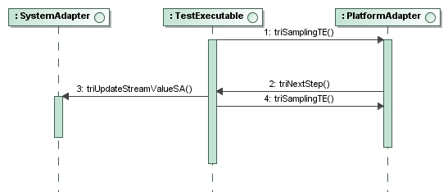
TRI Interaction for Stimulation
Stimulation is triggered by the TE
TE sets the actual period length
PA informs the TE when end of period is reached
TE updates the stream value

Slide 31
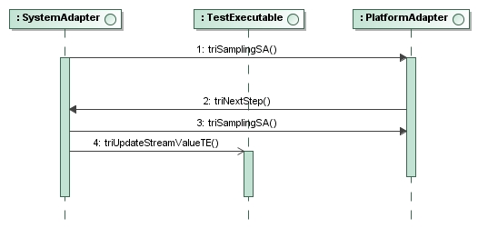
TRI Interaction for Measurement
Measurement is triggered by the SA
TA sets the actual period length
PA informs the SE when end of period is reached
SA updates the stream value

Slide 32
Example

Slide 33
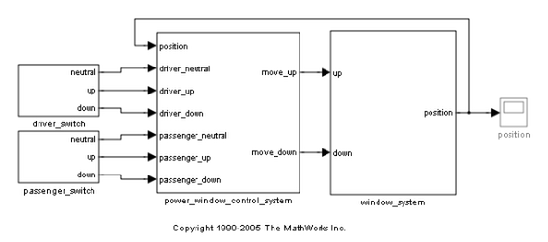
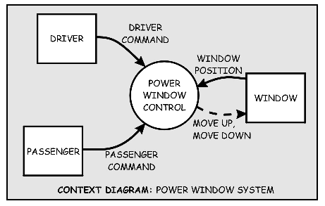
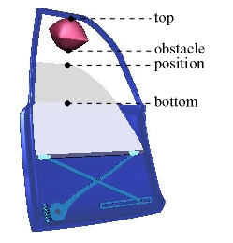
Demo
Testing a window lifter application in simulation

Slide 34
TestInterface
type port StreamIn stream {in float}
type port StreamOut stream {out float}
type component Tester {
port StreamOut Driver_Up;
port StreamOut Driver_Down;
port StreamOut Passenger_Up;
port StreamOut Passenger_Down;
port StreamOut Obstacle;
port StreamOut ObstacleSize;
port StreamIn position;
port StreamIn move_up;
port StreamIn move_down;
}

Slide 35
specification Test Case: DriverUpDown
Driver presses up-Button. The window opens (i.e. the position value increases)
When the position reaches the value 4, the down-Button is pressed and the window is closing (i.e. the position value decreases).
We check weather the decrease holds for 4 seconds
Finally we close the window completely.

Slide 36
source code Test Case: DriverUpDown
testcase DriverUpDown () runs on Tester {
setverdict(pass);
Driver_Up:= 0.0;
Driver_Down:=1.0;
log("Start test case");
log("Window Down");
cont {assert( position >= position.prev)}
until {[duration > 4.0] {Driver_Down:= 0.0}}
log("Window Up");
Driver_Up:=1.0;
log(position);
cont {} until {[duration > 0.2] {}}
log("Check Window Up");
cont {assert( position <= position.prev() )}
until {[duration > 4.0] {}}
// Clean up
cont {} until {[position < 0.0] {}}
Driver_Up:=0.0;
Driver_Down:=0.0;
} //testcase

Slide 37
specification Test Case: PassengerUpObstacle
Driver presses up-Button. The window opens (i.e. the position value increases)
When the position reaches the value 8, the up-Button is released and after a while the down-Button is pressed and the window is closing (i.e. the position value decreases).
When the position reaches the value 3, an obstacle is introduced and the window stops closing immediately.
We check weather the window stops and holds the position for at least 2 second.
Afterwards the obstacle is removed and the window closed completely.

Slide 38
source code Test Case: PassengerUpObstacle
testcase PassengerUpDownObstacle () runs on Tester {
setverdict(pass);
Passenger_Up:= 0.0;
Passenger_Down:=1.0;
log("Start test case");
log("Window Down");
cont {} until {[duration > 0.2] {}}
cont {assert( position >= position.prev )}
until {[duration > 4.0] {Passenger_Down:= 0.0}}
log("Window Up");
Passenger_Up:= 1.0;
log(position);
cont {} until {[duration > 0.2] {}}
log("Check Window Up");
cont { assert( position <= position.prev )}
until {[position < 4.0] {Obstacle:=1.0;}}
…

Slide 39
source code Test Case: PassengerUpObstacle
…
cont { assert( position <= position.prev )}
until {[position < 4.0] {Obstacle:=1.0;}}
cont {assert( position >3.5 )}
until {[duration > 2.0] {}}
Obstacle:=0.0;
cont {} until {[position < 0.0] {}}
Passenger_Up:= 0.0;
Passenger_Down:=0.0;
} //testcase

Slide 40
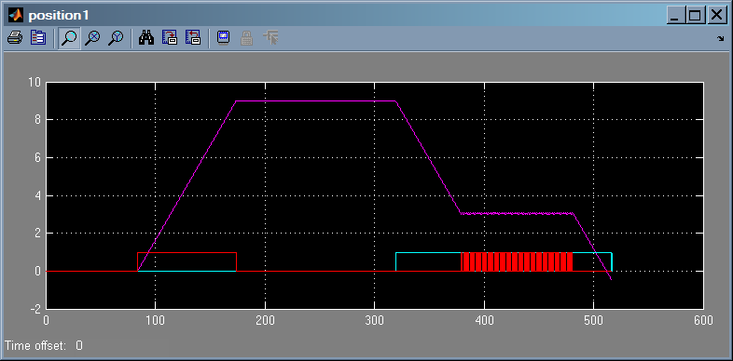
Test Results

Slide 41
Contact and Info
www.temea.org
Jürgen Großmann
Fraunhofer FOKUS
Kaiserin-Augusta-Allee 31,10589 Berlin
Tel: +49-30-3463-7390
juergen.grossmann@fokus.fraunhofer.de
Notes:
Kurzprofil Fraunhofer Institut FOKUS
Die gestiegen Herausforderungen im Automotive Software Engineering sind die Treiber für die Forschungs- und Entwicklungsarbeiten am Fraunhofer Institut FOKUS.
Automotive Software schafft innovative Sicherheitssysteme, befindet sich jedoch im Spannungsfeld von Kostenreduktion und Qualitätssteigerung

Slide 42
Short Hand Notation

Slide 43
syntax Short Hand for Simple Streams
seq{
cont{a:=1}until(duration>=5);
cont{a:=2}until(duration>=5);
cont{a:=3}until(duration>=5);
}
// short hand
{a:=1[duration>=5],a:=2[duration>=5],a:=3[duration>=5]}
// short hand
(a):={1[duration>=5],2[duration>=5],3[duration>=5]}
// or shorter
(a):={1[duration:5],2[duration:5],3[duration:5]}
// shortest
(a):= {1,2,3} with {stepsize:= 5.0}

Slide 44
syntax Short Hand for Simple Assertions
seq{
cont{assert(a==1)}until(duration>=5);
cont{assert(a==2)}until(duration>=5);
cont{assert(a==3)}until(duration>=5);
}
// short hand
assert((a)=={1[duration>=5.0],
2[duration>=5.0],
3[duration>=5.0]})
// or shorter
assert ((a)=={1[duration:5.0],
2[duration:5.0],
3[duration:5.0]})
// shortest
assert((a)=={1,2,3} with {stepsize:= 5.0})

Slide 45
syntax Short Hand for Assertions using Templates
template float templ := (-infinity..10.0);
seq{
cont{assert(match(port1,templ))}until(duration>=5);
cont{assert(match(port2,templ))}until(duration>=5);
cont{assert(match(port3,templ))}until(duration>=5);
}
// short hand
assert(match({port1[duration>=5.0],
port2[duration>=5.0],
port3[duration>=5.0]},(templ)));
// or shorter
assert (match({port1[duration:5.0],
port2[duration:5.0],
port3[duration:5.0]},(templ)));
// or shorter
assert(match ({1,2,3} with {stepsize:= 5.0},(templ)));
// or shortest
assert({1,2,3} with {stepsize:= 5.0},(templ));

Slide 46
syntax Short Hand for Complex Assertions
// short hand
assert(match({port1[duration>=5.0],
port2[duration>=5.0],
port3[duration>=5.0]}, {templ1[duration>=2.0],
templ2[duration>=9.0],
templ3[duration>=4.0]}));
// or shorter
assert (match({port1[duration:5.0],
port2[duration:5.0],
port3[duration:5.0]},
{templ1[duration:2.0],
templ2[duration:9.0],
templ3[duration:4.0]}));
// or shortest
assert({1,2,3} with {stepsize:= 5.0},
{templ1[duration:2.0],
templ2[duration:9.0],
templ3[duration:4.0]}));

